Slide 3
Host A
Host B
Host C
Host D
Host E
Host F

Slide 4
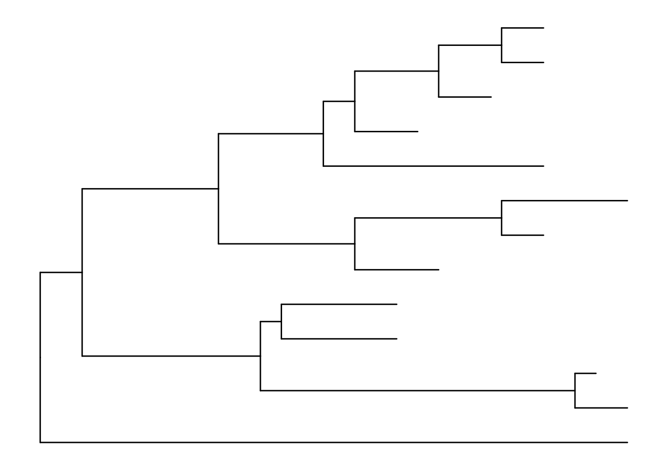
Host A
Host B
Host C
A
B
Host D
Host E
Host F

Slide 5
A
B
C
A
(C, D, E)
B
(C, D, E)
D
E

Slide 6
A
B
C
A
C? D?
B
C? D?
D

Slide 7
A
B
C
A
B
?
D recombinants
?
D

Slide 8
A
A
B
B
Time
C
C
D
D
E
F
E
F

